Slide 1
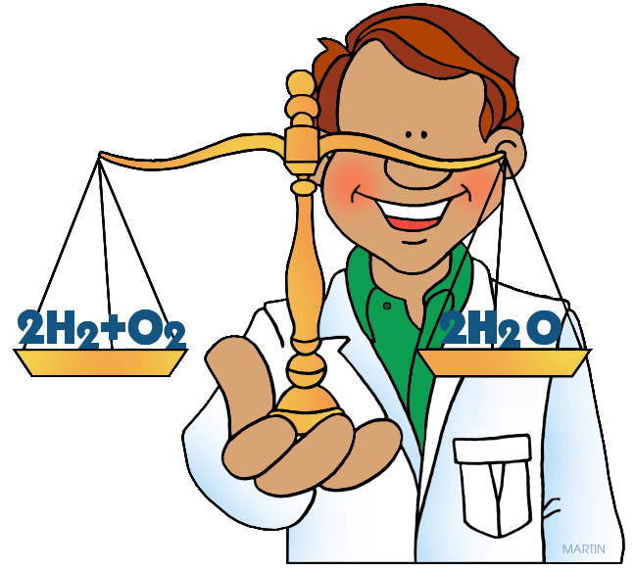
Balancing Chemical Equations
March 2017

Slide 2
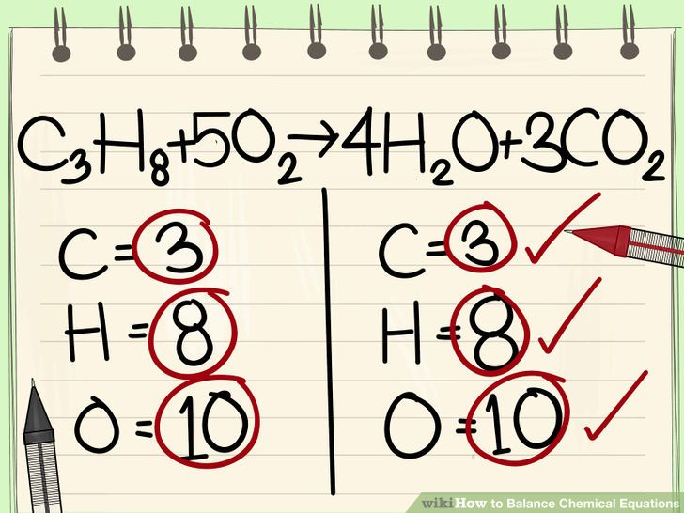
Balancing Chemical Equations
The equation on the right is said to be “balanced” because:
the number of atoms of each element on the left side of the arrow
=
the number of atoms of each element on the right side of the arrow

Slide 3
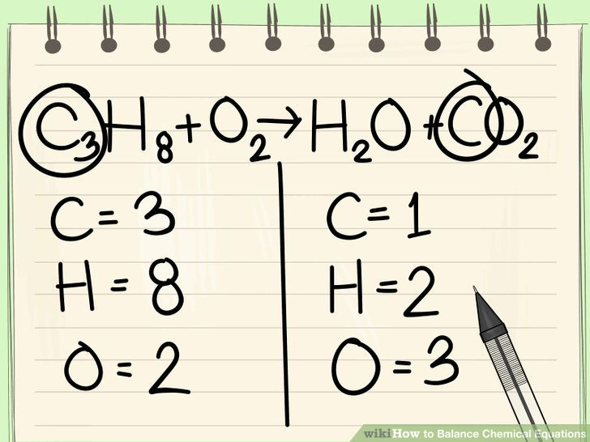
Balancing Chemical Equations
The equation on the right is NOT BALANCED
To balance the atoms, numbers called “coefficients” need to be added in front of the substances that contain unbalanced atoms.

Slide 4

Let’s start with a simpler example:
Na_{(s)} + Cl₂ _{(g)} → NaCl
Na = Na =
Cl = Cl =

Slide 5
Here is another example:
Na_{(s)} + O₂ _{(g)} → Na₂O
Na = Na =
O = O =
In this example it is easier to start by balancing the oxygen first

Slide 6
Here is another example with a polyatomic ion:
Na₂SO₄ _{(aq)} + BaCl₂ _{(aq)} → NaCl_{(aq)} + BaSO_{4(s)}
Na = Na =
SO₄²⁻ = SO₄²⁻ =
Cl = Cl =
In this example it is easier to keep the S and O as SO₄²⁻

Slide 7
Here is another example with a polyatomic ion:
NaOH _{(aq)} + MgCl₂ _{(aq)} → NaCl_{(aq)} + Mg(OH)₂ _{(s)}
Na = Na =
OH⁻ = OH⁻ =
Mg = Mg =
Cl = Cl =

Slide 8
Here is a more challenging example:
N₂ _{(g)} + H₂ _{(g)} → NH₃ _{(g)}
N = N =
H = H =

Slide 9
Here is a more challenging example:
CH₄ + O₂ → CO₂ + H₂O
C = C =
H = H =
O = O =
Oxygen is difficult to balance since it appears in 2 of the products.
It is easier to start balancing something other than oxygen.

Slide 10
Now let’s try our first example:

